Slide 1
Section-2 Descriptive Versus Explanatory Analysis
Drivers behind Marketing Engagement

Slide 2
Drivers Behind Marketing Engagement
When you run marketing campaigns, one of the important measures that you will want to look at and analyze is customer engagement with your marketing efforts.
For example, in email marketing, customer engagement can be measured by how many of your marketing emails were opened or ignored by your customers.
Customer engagement can also be measured by the amount of website visits from individual customers.
Successful marketing campaigns will draw a lot of engagement from your customers, while ineffective marketing campaigns will not only drive a lower amount of engagement from your customers but will also negatively impact your business.
Customers might mark emails from your business as spam or unsubscribe from your mailing list.

Slide 3
Drivers Behind Marketing Engagement
In order to understand what affects customer engagement, in this chapter, we will discuss how we can use explanatory analysis (more specifically, regression analysis).
Will briefly cover the definition of explanatory analysis, what regression analysis is, and how to use a logistic regression model for explanatory analysis.
Then, we will cover how to build and interpret regression analysis results in Python, using the statsmodels package.
For R programmers, we will discuss how we can build and interpret regression analysis results with glm.
In this chapter, we will cover the following topics:
Using regression analysis for explanatory analysis
Regression analysis with Python
Regression analysis with R

Slide 4
Using regression analysis for explanatory analysis
Here, discuss why, when, and how to use explanatory analysis for marketing.
Explanatory analysis and regression analysis:
The purpose of the explanatory analysis is to answer why we are using the data.
whereas the purpose of descriptive analysis is to answer what we are using the data for, and how we are using it.
When you run different marketing campaigns, oftentimes, you will notice that some marketing campaigns perform much better than others;
you might wonder why it is that some of your marketing campaigns work so well, while others do not.
For example, you might want to understand what types and groups of customers typically open your marketing emails more often than others.
As another example, you might want to analyze what attributes of the customer base are highly correlated with higher conversion rates and item purchases.

Slide 5

Using regression analysis for explanatory analysis
With explanatory analysis, analyze and understand the key factors that are highly and significantly correlated with the outcomes.
Regression analysis and regression models are frequently used to model the relationships between the attributes and the outcomes.
Regression analysis estimates the values of output variables by finding a function of the attributes or features that best approximates the output values.
One of the frequently used forms of regression analysis is linear regression.
As the name suggests, in linear regression, we try to estimate the output variables via linear combinations of the features.
If we use Y for the output variable and X, for each of the features, where i is the ith feature, then the linear regression formula will look as follows:

Slide 6
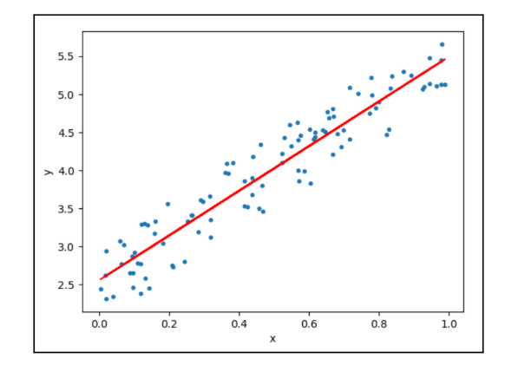
Using regression analysis for explanatory analysis
From the preceding formula, the output variable Y is expressed as a linear combination of the features, X.
The purpose of the linear regression models is to find the intercept, a, and the coefficients, b1, that best estimate the output variable, using the given features.
A fitted linear regression line will look something like the following:

Slide 7
Using regression analysis for explanatory analysis
The blue dots in this diagram are the data points, and the red line is the fitted, or trained, linear regression line.
As displayed in the graph, linear regression tries to estimate the target variable through a linear combination of the features.

Slide 8

Logistic regression
Logistic regression is a type of regression analysis that is used when the output variable is binary (one for a positive outcome versus zero for a negative outcome).
Like any other linear regression models, logistic regression models estimate the output from linear combinations of the feature variables.
The only difference is what the model estimates. Unlike other linear regression models, logistic regression models estimate the log odds of an event, or, in other words, the log ratios between the probabilities of positive and negative events.
The equation looks as follows:

Slide 9
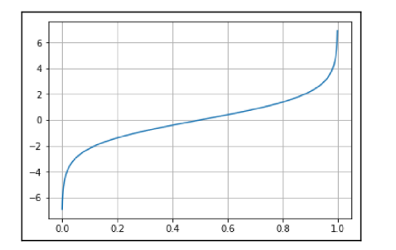
Logistic regression
The ratio on the left is the odds of success, which represents the ratio between the probability of success and the probability of failure.
The curve of the log odds, also called the logit curve, looks as follows:

Slide 10
Logistic regression
The logistic regression model output is simply the inverse of logit, which ranges from zero to one.
In this chapter, we are going to use regression analysis to understand what drives customer engagement, and the output variable will be whether a customer responded to marketing calls.
Hence, logistic regression fits perfectly in this case, as the output is a binary variable that can take two values: responded versus did not respond.

Slide 11
Regression Analysis with Python
Use statsmodels package in python to conduct regression analysis
Dataset is publicly available from IBM Watson named “WA_Fn-UseC_-Marketing-Customer-Value-Analysis.csv”
Use matplotlib and pandas packages for data analysis and visualization
Load the data as follows:
df = pd.read_csv('../data/WA_Fn-UseC_-Marketing-Customer-Value-Analysis.csv')
df.shape

Slide 12
Data Analysis and Visualizations
First understand the data, with respect to what data points we have, and what patterns we can see.
Find the column named “Response”, it contains information on whether a customer responded to marketing calls.
This column is used to measure of customer engagement
Encode this column value as numeric for future use.
df['Engaged'] = df['Response'].apply(lambda x: 0 if x == 'No' else 1)

Slide 13
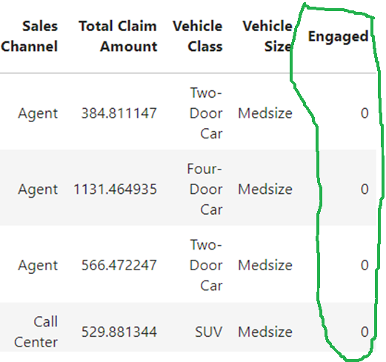
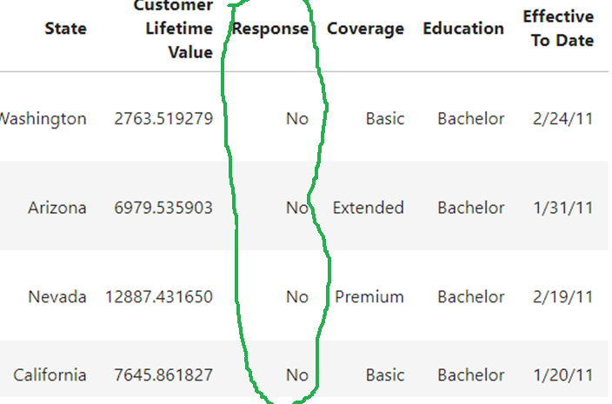
Data Analysis and Visualizations

Slide 14
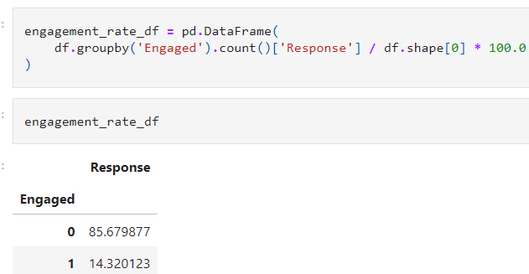
Engagement Rate
This rate is the percentage of customers that responded to the marketing calls.
engagement_rate_df = pd.DataFrame(
df.groupby('Engaged').count()['Response'] / df.shape[0] * 100.0)

Slide 15
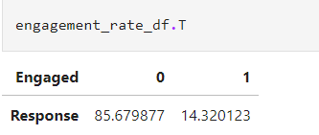
Engagement Rate
To see the result in easy war, flip the rows and columns
From the above results, 14% of customers have responded to marketing calls and the remaining 86% of the customers have not responded.

Slide 16
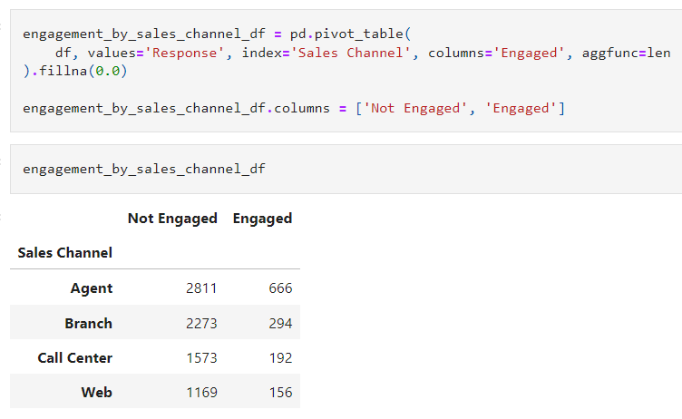
Sales Channels
Next, Find any noticeable patterns in the sales channel and engagement.
To find insights easily, visualize through a pie chart. From the graph, more than half of the engaged customers were from agents. Whereas non-engaged customers are more evenly distributed across all 4 different channels

Slide 17
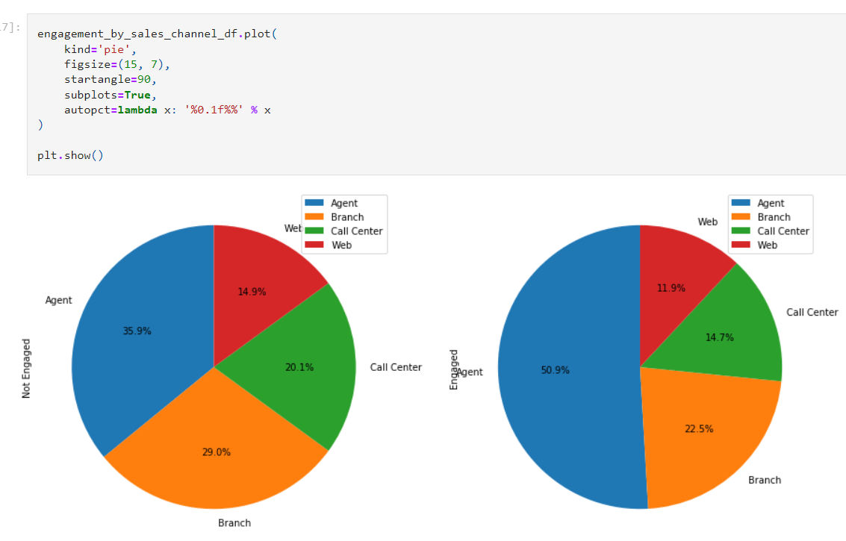
Sales Channels

Slide 18
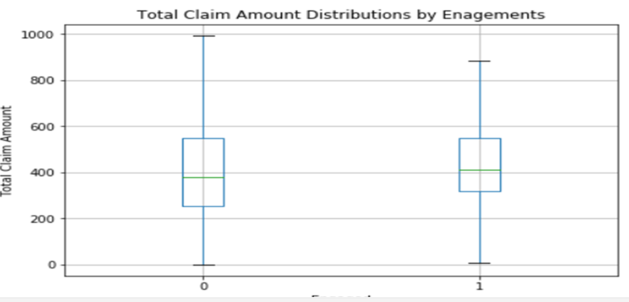
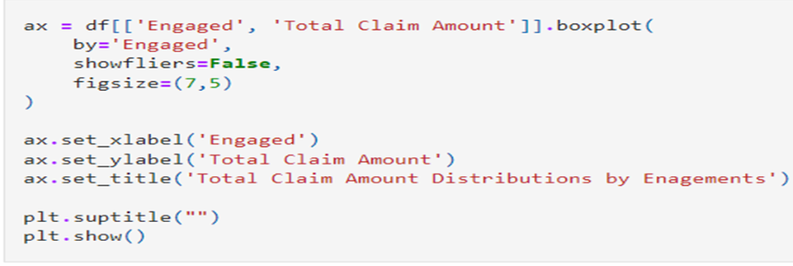
Total claim amounts
Next, find the differences in the distribution of total claim amount between the engaged and non-engaged groups.

Slide 19
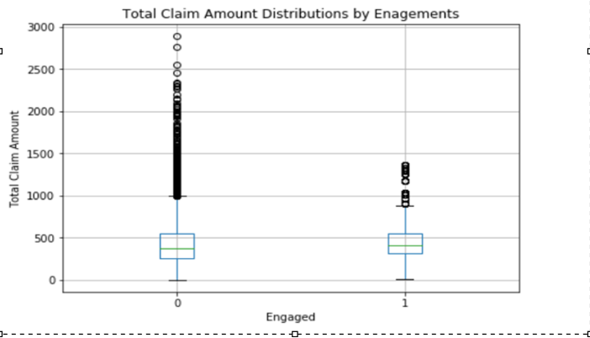
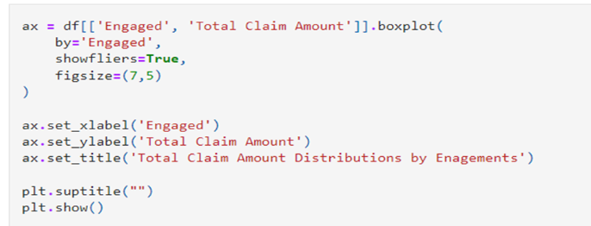
Total claim amounts –with showfliers as TRUE

Slide 20
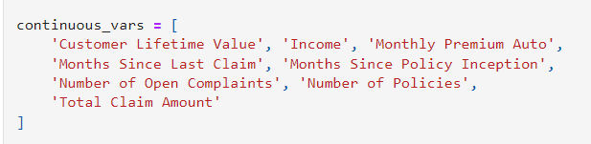
Regression Analysis- Continuous variables
In linear regression, including logistic regression, it is straightforward to fit a regression model when the feature variables are continuous, as it just needs to find a linear combination of feature variables with numerical values for estimating the output variable.
From describe() function, find all continuous variables in the given dataset.

Slide 21
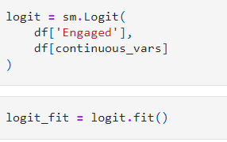
Regression Analysis- Continuous variables
Fit a logistic regression model with the above set of continuous variables as input variables using the following code:

Slide 22
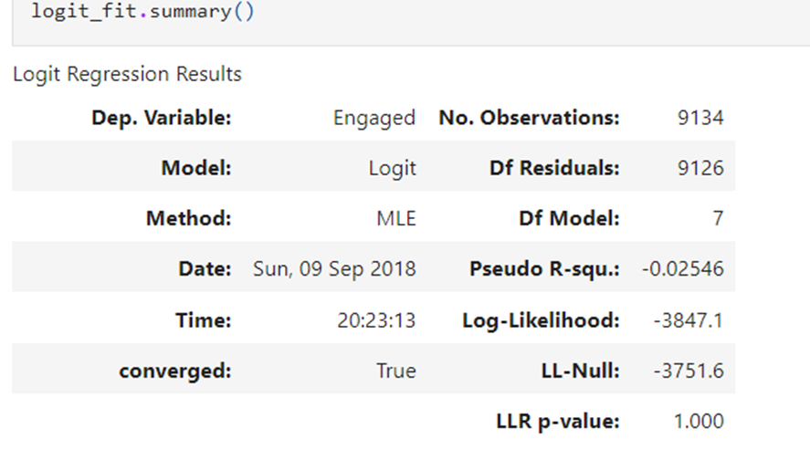
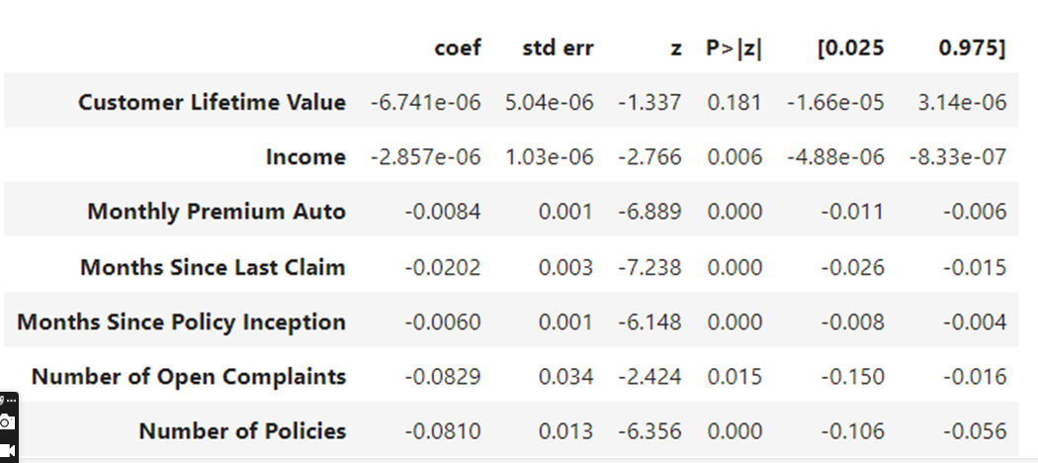
Regression Analysis- Continuous variables

Slide 23
Regression Analysis- Continuous variables
From the above output, coef represents the coefficients for each of the input variables.
The p>|z| column represents the p-value, which denotes the relationship between the feature and the output variable
Any value less than 0.05 signifies a strong relationship
Few variables have a significant relationship with output variables.
For ex, Number of policies variable is significant and is negatively correlated with Engaged.
This suggests that the more policies that the customer has, the less likely they are to respond to marketing calls.
Another Ex, the Months Since Last Calls variable is significant and is negatively correlated with the output variable.
This means that the longer it has been since the last claim, the less likely that the customer is going to respond to marketing calls

Slide 24
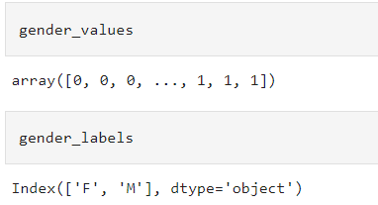
Regression Analysis-Categorical Variables
Using continuous variables, interpretation is quite simple and easy.
But it is not straightforward for categorical variables
One of the ways to handle such variables is to factorize using the following code:
gender_values, gender_labels = df['Gender'].factorize()
df['GenderFactorized'] = gender_values

Slide 25
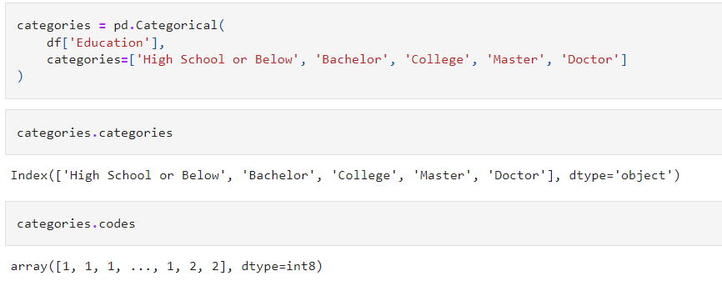
Regression Analysis-Categorical Variables
Another way to encode a categorical variable Education with 5 different categories.

Slide 26
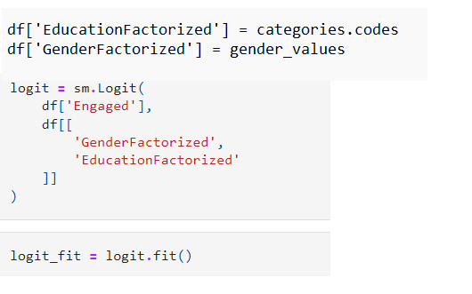
Regression Analysis-Categorical Variables
Add both categorical variables and build a model as follows:

Slide 27
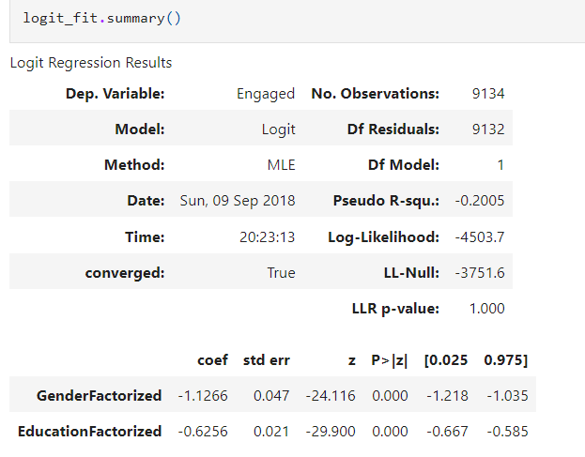
Regression Analysis-Categorical Variables

Slide 28
Regression Analysis-Categorical Variables
From the above output, both variables seem to have significant relationship with the output variable “Engaged”
Based on the coefficients of both variables, they are negatively correlated
Male customers are less likely to be engaged in marketing calls as compared with female customers.
Similarly, the higher the customer’s education levels are the less likely that they will be engaged in marketing calls

Slide 29
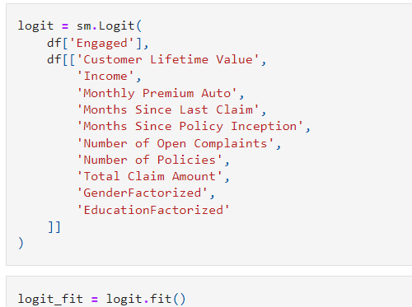
Combining Continuous and categorical variables

Slide 30
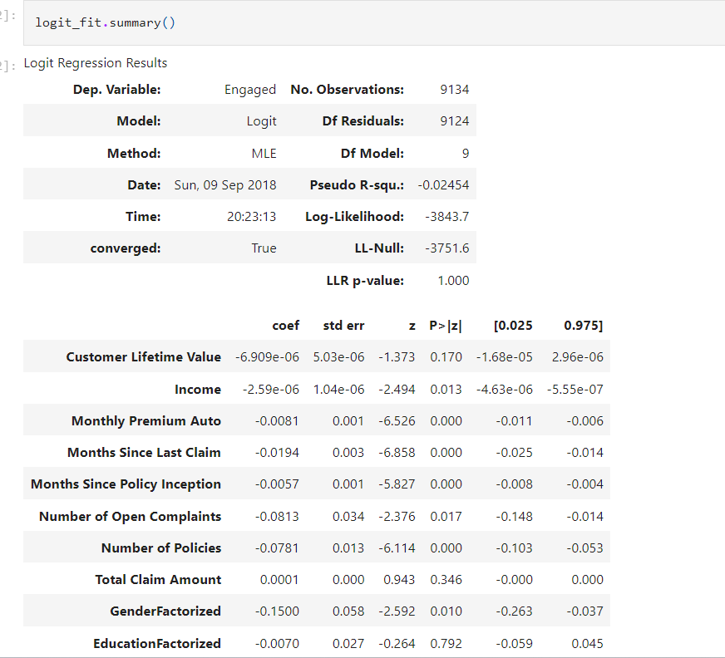

Slide 31
Combining Continuous and categorical variables
From the above output the variables, 'Customer Lifetime Value’, 'Income’, 'Monthly Premium Auto’, 'Months Since Last Claim’, 'Months Since Policy Inception’, 'Number of Open Complaints’, 'Number of Policies','GenderFactorized’ are significant and all of them have negative relationships.
Hence, the higher the income is the less likely that the customer will be engaged with marketing calls

Slide 32
Regression Analysis with R
Use glm function in R to conduct regression analysis
Dataset is publicly available from IBM Watson named “WA_Fn-UseC_-Marketing-Customer-Value-Analysis.csv”
Use dplyr and ggplot2 packages for data analysis and visualization
Load the data as follows:
df <- read.csv(
file="~/Documents/data-science-for-marketing/ch.3/data/WA_Fn-UseC_-Marketing-Customer-Value-Analysis.csv",
header=TRUE,
sep=","
)

Slide 33
Data Analysis and Visualizations
First understand the data, with respect to what data points we have, and what patterns we can see.
Find the column named “Response”, it contains information on whether a customer responded to marketing calls.
This column is used to measure of customer engagement
Encode this column value as numeric for future use.
df$Engaged <- as.integer(df$Response) – 1
As.integer function encodes the value as 1 & 2 by default

Slide 34
Data Analysis and Visualizations

Slide 35
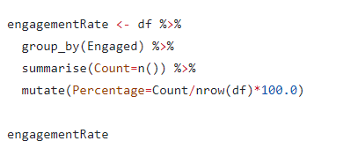
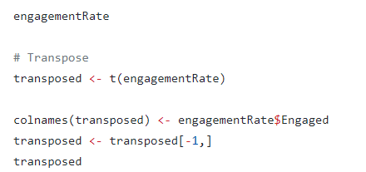
Engagement Rate
This rate is the percentage of customers that responded to the marketing calls.

Slide 36
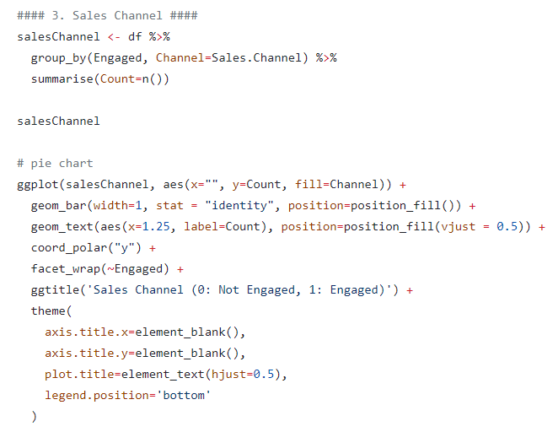
Sales Channels

Slide 37
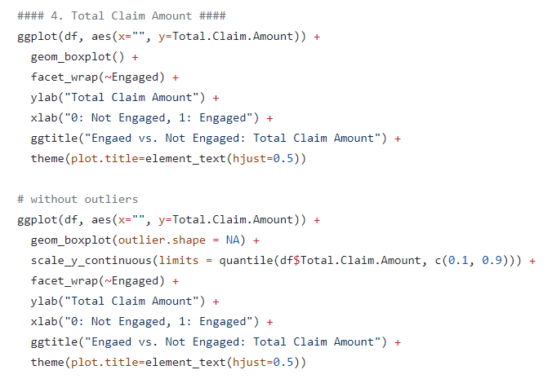
Total claim amounts

Slide 38
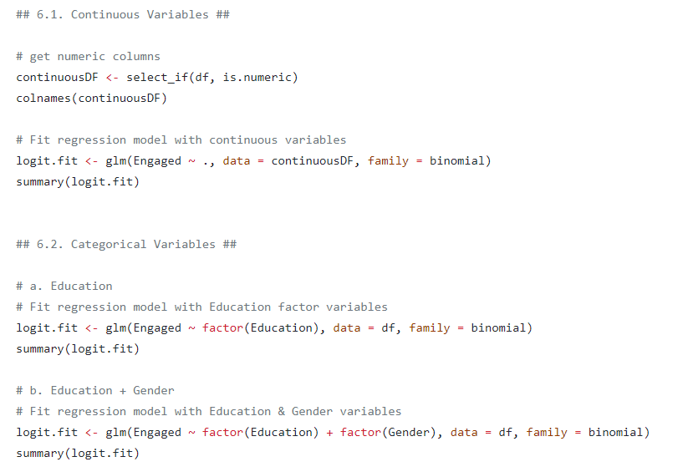
Regression Analysis- Continuous, Categorical variables

Slide 39
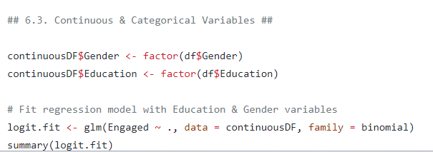
Combining Continuous and categorical variables

